Slide 1
TS V/S JS

Slide 2
01 JavaScript (JS)
02 TypeScript (TS)
03 TypeScript Environment Setup
04 Types
05 Enum
06 Functions
07 Interfaces & Classes

Slide 3
01
JAVASCRIPT
Notes:
We all have seen javaScript growing in last few years we have got much better execution environment of javaScript, we have seen html5 which has made a lot of improvements in UI making the web development a full-fledged programming platform.

Slide 4
JAVASCRIPT(JS)
JavaScript is a weakly typed client-side scripting language
Notes:
But the fact is, writing application in javaScript is really hard. Javascript is not really designed to be programming language to write large application. It is scripting language, it doesn’t have static typing

Slide 5
GOOD & BAD ABOUT JS
The Good
The Bad
Its Everywhere
Huge amount of libraries
Flexible
Dynamic typing
Lacks structuring mechanisms

Slide 6
02
TYPESCRIPT
Notes:
Few years ago, people used to use tools like google web toolkit, scriptsharp that is an opensource project that uses c-sharp. These use a mature tooling systems like eclipse and visual studio and give you development process that works for large apps. In that sense it is a stpe forward to use these tools. The problem with these is you end writing a language that is not javascript and whenever we want to use anything happening in javascript community it becomes a little difficult. Microsoft came up with something that strengthen javascript with the things that are missing for large scale app development like static typing, classes, modules. That is what typescript is about.

Slide 7
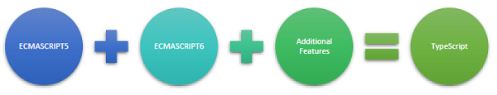
TYPESCRIPT
JavaScript is not originally designed for large complex applications (mostly a scripting language, with functional programming constructs), lacks structuring mechanisms like Class, Module, Interface.
Typescript is a typed superset of JavaScript that compiles to plain JavaScript.
Adds additional features like Static Type (optional), Class, Module etc. to JavaScript
Microsoft technology
Open Source

Slide 8
TYPESCRIPT
" TypeScript? Its like coding JavaScript but without the pain "
-Someone on Hacker News

Slide 9

HOW DOES TYPESCRIPT WORK?
TypeScript (file.ts)
JavaScript (file.js)
TypeScript Compiler
“Transpiling”
Notes:
And this compiled code can run in any browser, any host any operating system. Apart from that it is open source

Slide 10
HOW DOES TYPESCRIPT WORK?
What does TypeScript do to add more scale?

Slide 11
TYPESCRIPT FEATURES
Optional static type annotations
Improved readability for functions
Supports Classes, interface, optional types, and more.
Notes:
Any valid ts can be changed to js and compiled
Iconic

Slide 12
03
TYPESCRIPT SETUP

Slide 13
Environment Setup
Via npm (the Node.js package manager)
$ npm install -g typescript
To know typescript version $ npm view typescript version

Slide 14
04
TYPES

Slide 15
TYPES
String
Number
Boolean
Array
Any
Union
Tuple
Custom Types
Core Types
User defined

Slide 16
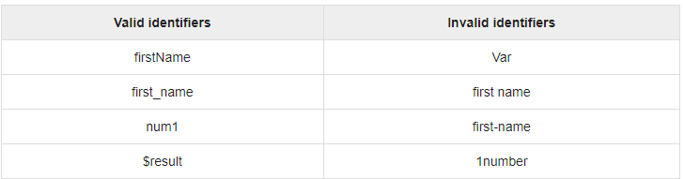
Valid and invalid identifiers

Slide 17
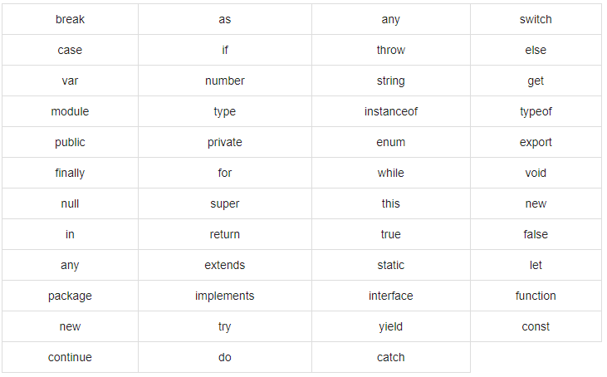
TypeScript ─ Keywords

Slide 18
STRING
Considering the following JavaScript code:
var message = “Hello World”;
Annotation
Type
Value
TypeScript
var message: string = “Hello World”;
Literal
Identifier

Slide 19
TEMPLATE STRING
Spans multiple lines
Embeds expressions
Example:
var name: string = “Bob”;
var age: number = 12;
var message: string = `Hello, my name is ${ name }
I’ll be ${ age + 1 } years old next month
`;
This is equivalent to declaring message as:
var message: string = "Hello, my name is " + name + ".\n\n" +
"I’ll be" + (age + 1) + "years old next month";

Slide 20
NUMBER
Supports integer, float, binary, octal & hexa-decimal numbers.
var integer: number = 15;
var float: number = 93.78;
var hex: number = 0xf00d;
var binary: number = 0b1010;
var octal: number = 0o744;

Slide 21
BOOLEAN
Stores true/false value
var isDone: boolean = true;

Slide 22
TYPE ANNOTATIONS/CHECKING
JavaScript
TypeScript
var name = ‘My Name’;
var age = 20;
var isEnabled = false;
var name: string = ‘My Name’;
var age: number = 20;
var isEnabled: boolean = false;
name = 10
// overrides the value
age = “200”
// overrides the value
name = 10
// cannot convert ‘string’ to number
age = “200”
// cannot convert ‘number’ to ‘string’

Slide 23
ERRORS AT COMPILE TIME
JavaScript
TypeScript
var value = 54;
value.trim()
var value: string = 54;
value.trim()
Runtime
Compile-time
TypeError: undefined is not a function
TypeError: cannot convert ‘number’ to ‘string’
Notes:
Talk about union types

Slide 24
ARRAY
First way:
var values: number[] = [12, 8, 19];
var tasks: string[] = ["read", "write"];
Second way:
var values: Array<number> = [12, 8, 19];
var tasks: Array<string> = ["read", "write"];

Slide 25
ANY
Describes the type that we don’t know.
var notSure: any = 4;
notSure = "maybe a string";
notSure = false; // maybe a Boolean too

Slide 26
05
ENUMS

Slide 27
ENUM
Enum is a way of giving more friendly names to sets of numeric values.
enum Color { Red, Green, Blue }
var defaultColor: Color = Color.Blue;
Default values:
enum Color { Red = 0, Green = 1, Blue = 2 }
Start from a different number or manually set all the values
enum Color { Red = 2, Green, Blue } // Red => 2, Green => 3, Blue => 4
enum Color { Red = 2, Green = 5, Blue = 9 } // Red => 2, Green => 5, Blue => 9

Slide 28
06
FUNCTIONS

Slide 29
FUNCTIONS
A block of code that does a particular task.
Several optional features: types, optional parameters, default parameters.
Optional type
function getName(name: string, id: number = 2) {
console.log('Welcome ' + name);
}
getName('Alex’);
getName();
//error: Expected 1-2 arguments but got 0
function getName(id:number,dd:string,name?: string,lastName?:string) {
console.log('Welcome ' + name);
}
getName(1,'Alex’,’xx’);
getName(); // works fine

Slide 30
07
INTERFACES & CLASSES

Slide 31
INTERFACES
Defines shape of an object.
Example
function printLabel(labelledObj: {label: string}) {
console.log(labelledObj.label);
}
var myObj = { label: 'Size of the Object' };
printLabel(myObj)

Slide 32
INTERFACES
Example
interface LabelledValue {
label: string;
size: number;
}
function printLabel(labelledObj: LabelledValue) {
console.log(labelledObj.label + ' is ' + labelledObj.size);
}
var myObj = { label: 'Size of the Object', size: 10 };
printLabel(myObj)

Slide 33
INTERFACES
Example
interface LabelledValue {
label: string;
size?: number;
}
function printLabel(labelledObj: LabelledValue) {
console.log(labelledObj.label);
}
var myObj = { label: 'Size of the Object'};
printLabel(myObj)

Slide 34
CLASSES
Why do we need Classes?
Creating Multiple new instances
Inheritance
Singleton Objects

Slide 35
CLASSES
var Car = (function () {
function Car(engine) {
this.engine = engine;
}
return Car;
})()
Example
class Car {
// property public by default
engine: string;
constructor(engine: string = ‘’) {
this.engine = engine;
}
}
Creating an instance
var hondaAccord = new Car('v6’);

Slide 36

INTERFACE V/S CLASS

Slide 37
INTERFACE V/S CLASS
Interfaces only provides shape to an object whereas class provides implementation of something.
According to Angular’s styleguide its recommended to use class over interfaces.
Notes:
According to Angular 2 styleguide it's recommended to use Class over Interface for the typing. The main difference is that class will persist when compiled while Interface are purely removed since they do not serve any usage.
Just stay consistent over the whole project, and prefer the styleguide approach with class, who know, maybe one day you will need to add method to your models.

